Slide 1
How to manage Menus in AU
Manage Menus for page visibility in AU

Slide 2
Process Info
Owner name | Annarose
Team | DnD
Resources | Docebo
Tools
Description | Manage the Menus used to make pages visible in AU
 | AU Member | AU Member | AU Member | AU Member | AU Member | AU Member | AU Member | AU Member | AU Member
Date

Slide 3
Menu Overview
Menus are used to make pages visible to users (much like how catalogs allow visibility of courses to users).
When a page is added to a menu, that page will appear on the User’s menu
If a user attempts to access a page that is not on a menu to which the user has visibility, they will see an “Unauthorized” screen.
All pages must belong so some menu, otherwise the only users in the system that will be able to see the page would be the Super Admins.

Slide 4
Menu Overview Cont.
If you have created a page and need to add it to an existing menu, use the guide below to determine which menu the page should go:
If you want the page to appear on the User Menu:
New Hire Axway Employees – for all new employees, the home page is a temporary landing page directing them to complete onboarding LP.
Employees – User menu for anyone in Employee branch
Partners – User menu for anyone in the Partner branch
Customers – User menu for anyone in the Customer branch
Prospects – User menu for anyone in the Prospects branch
If you want the page to be visible, but not appear on the User Menu:
EMP-VIS – for anyone in the employee branch
PAR-VIS – for anyone in the partner branch
CUS-VIS – for anyone in the customer branch

Slide 5
Steps
Create new Menu
Update menu settings
Add pages to menu
Arrange menu hierarchy

Slide 6
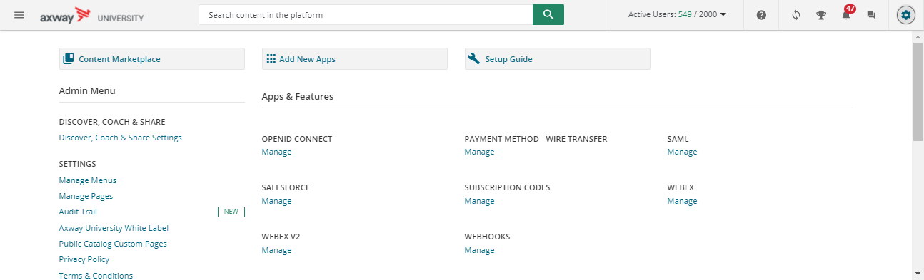
Step 1 – Create new Menu
Access Admin menu
Select Manage Menus (under the settings section)
1
2

Slide 7
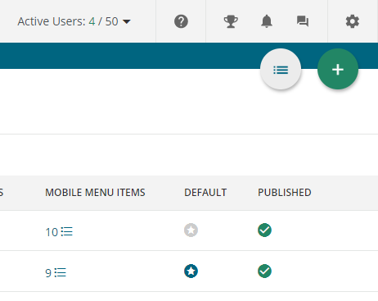
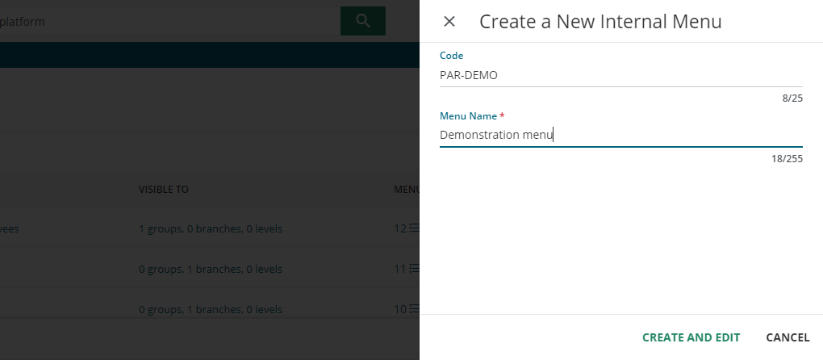
Step 1 – Create Menu
Click green plus button
Add a code for the page. You must add a prefix for the audience type:
“EMP-” for Employee
“CUS-” for Customer
“PAR-” for Partner
“PRO-” for Prospect
Add a Name
Click Create and Edit
1
2
3
4

Slide 8
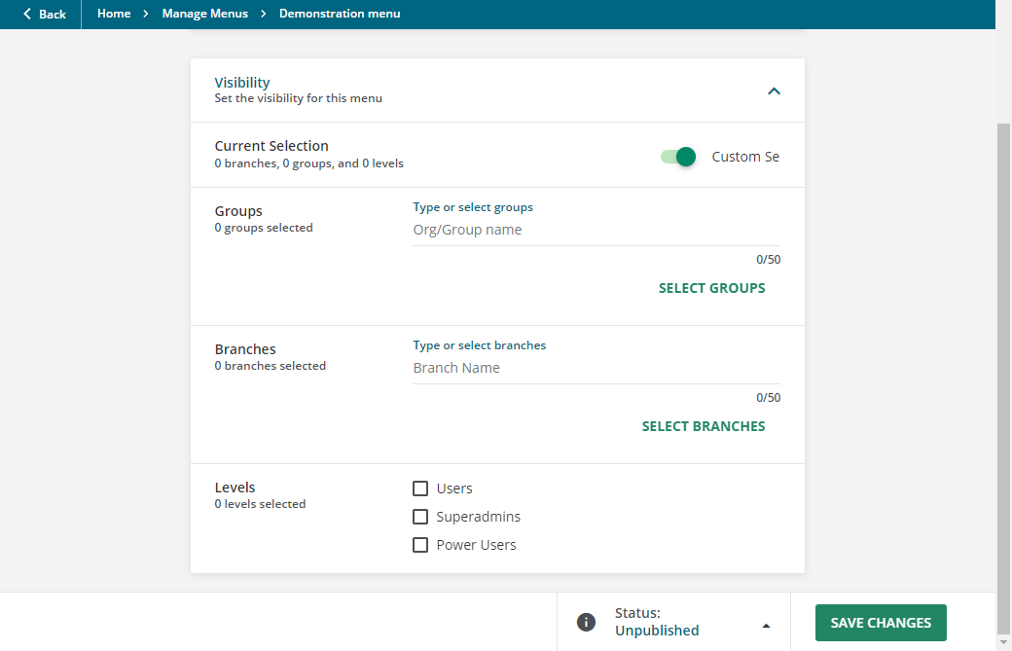

Step 2 – Update menu settings
Update Code or name, if necessary, then set Menu Visibility (who will be able to see the pages associated to the menu)
Expand the Visibility section
Toggle the Custom selection switch
Select the visibility based on the following criteria:
Group
Branch
Level
Users – regular learners
Super Admins
Power Users – you must select the Power User profile that the menu would apply.
You can select one or all visibility criteria, depending on how specific you want your audience to be.
1
2
3

Slide 9
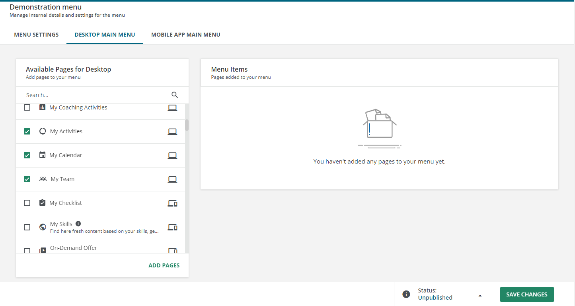
Step 3 – Add Pages to menu
Click the Desktop Menu tab
Select the pages you want to add to the menu from the “Available Pages for Desktop” section
You can search for pages by name if you need to locate specific pages.
Click Add Pages
1
2
3

Slide 10
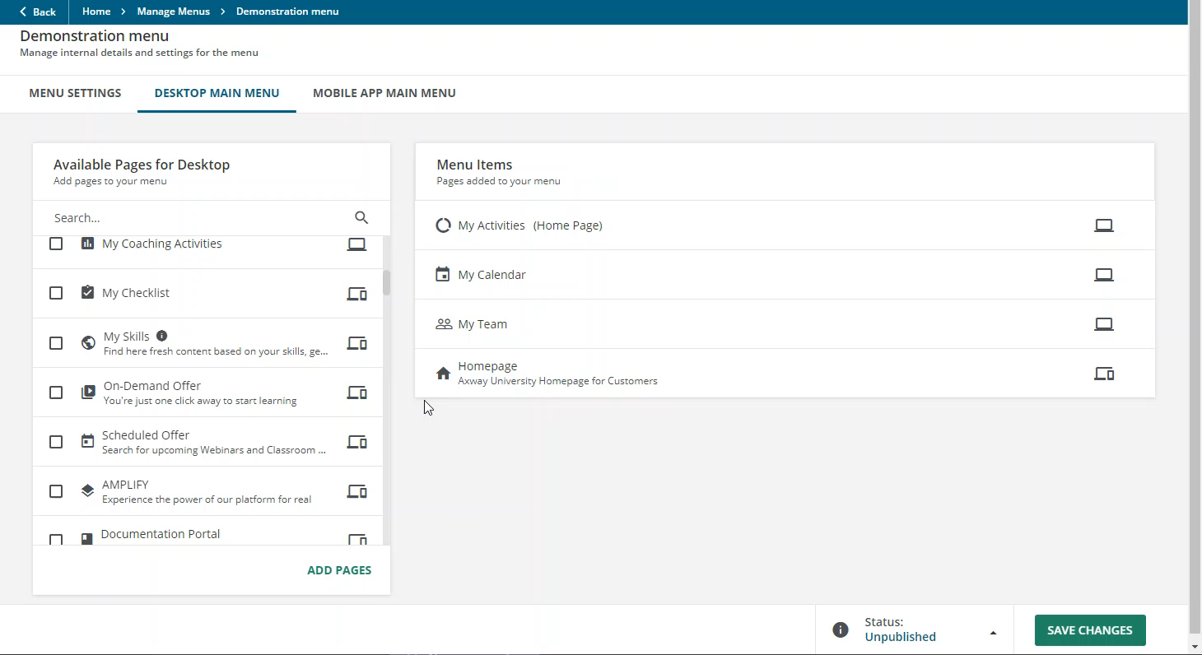
Step 3 – Add Pages to menu
On the Menu items area, click and drag the pages to put them in the necessary order
The page listed at the top of the Menu Items section will be the homepage, so make sure the correct page is listed at the top.
Update status to Published
Click Save Changes
Play video to see how to change page order.
4
5
6

Slide 11
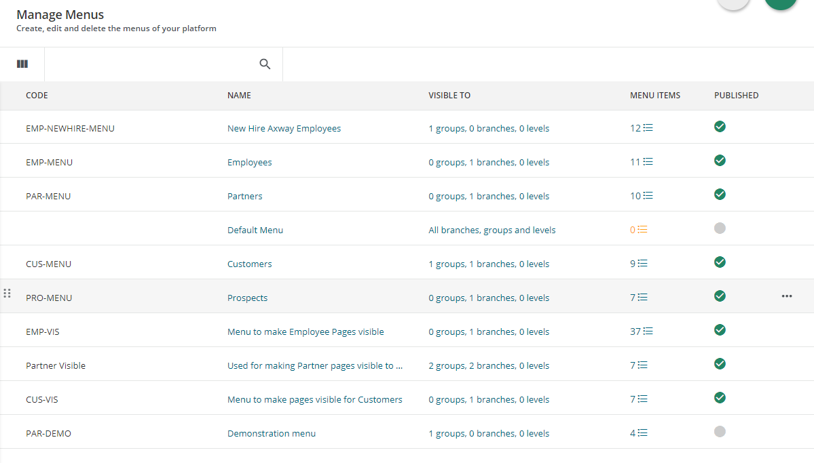
Step 4 – Arrange Menu Hierarchy
On the Manage Menu main page, you must arrange the menu hierarchy appropriately, otherwise the user will not see the correct menu. Use these guidelines to determine where the new menu should appear:
If it is a specific group of users that has been given visibility, move the menu to the top of the list
if you put the menu below the generic Employee, Partner, Customer or Prospect menus, the users would qualify for those menus first and will not see the specific menu
If it is a menu for a new branch – place the menu below the generic Employees menu
If the menu is being used to provide visibility to pages without adding pages to a menu (and this is for a very specific group of people), place the menu above the EMP-VIS menu, but below the Prospect menu.
If the menu is being used to provide visibility to pages without adding pages to a menu and this is for a new branch, place the menu at the very bottom of the list
1
2
3
4

Slide 12
Summary
Create new Menu
Update menu settings
Add pages to menu
Arrange menu hierarchy

